Slide 1

Stock Market Exploration A Dive into Market Dynamics
DSCI 505 U15: Business Analytics Fundamentals
Instructor: Chad Birger
Yogesh Siyyadri - 101164082

Slide 2

A Data Driven Journey
Today, I'll dive into the captivating realm of time series data, an essential chronological narrative for analysts and traders. I'll zoom in on tech giants like Apple, Amazon, Google, and Microsoft, leveraging y-finance to extract crucial stock details. With Seaborn and Matplotlib, I'll bring this data to life visually.
Let's explore the diverse applications of time series data, unlocking valuable insights for analyzing stock risks based on historical performance. Join me as I unravel the intricacies of the stock market, providing clarity through a data-driven perspective.

Slide 3
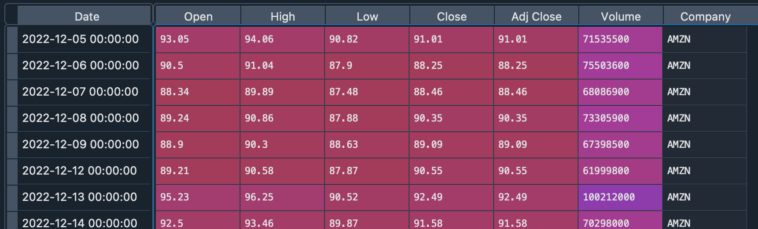
The change in price of the stock overtime
Here, we will investigate the process of retrieving stock information using pandas and analyzing fundamental attributes of a stock.

Slide 4
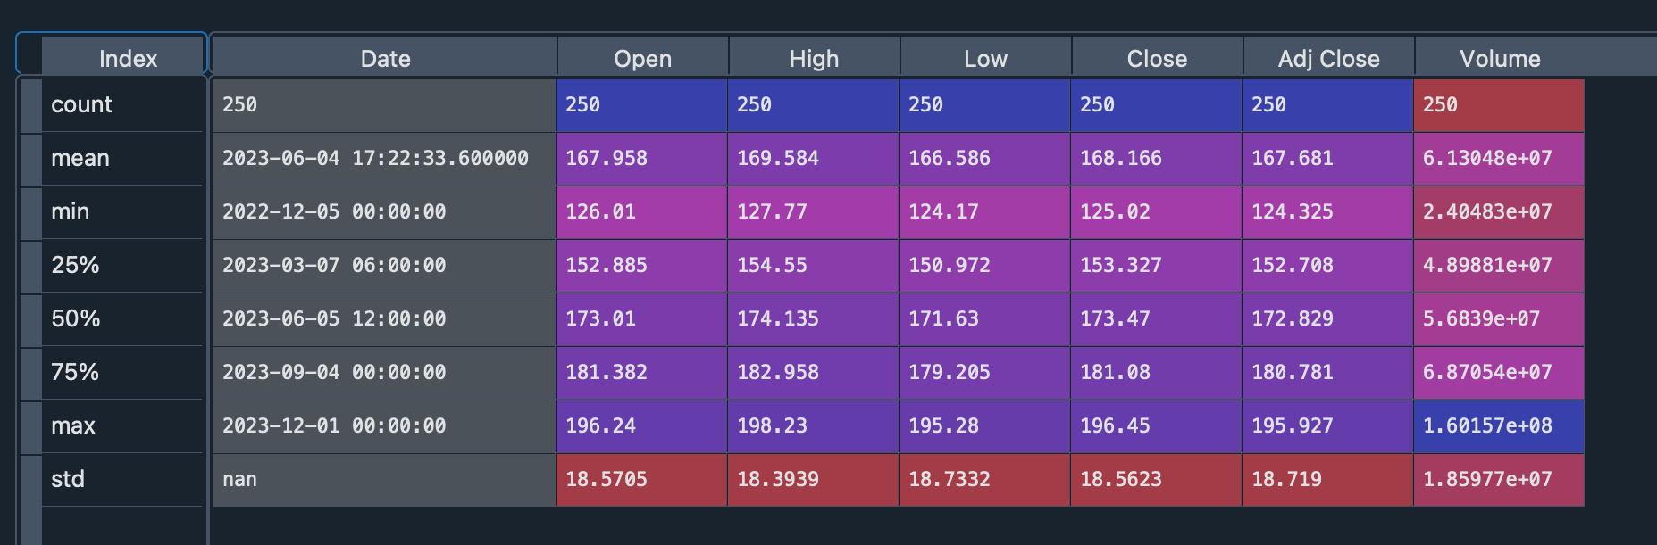
Descriptive Statistics about the Data
The `.describe()` method generates descriptive statistics for a dataset, summarizing central tendency, dispersion, and distribution shape, excluding NaN values. It analyzes both numeric and object series, as well as mixed data types within Data Frame columns, providing insights into the dataset's characteristics. The output varies based on the provided data.

Slide 5
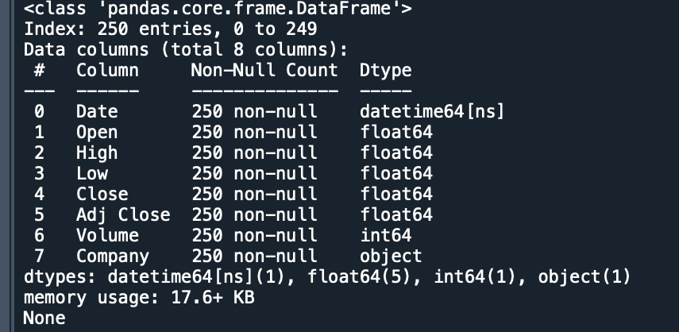
The ‘info()’ method provides comprehensive details about a Data Frame, including the data types of the index and columns, the count of non-null values, and memory usage

Slide 6
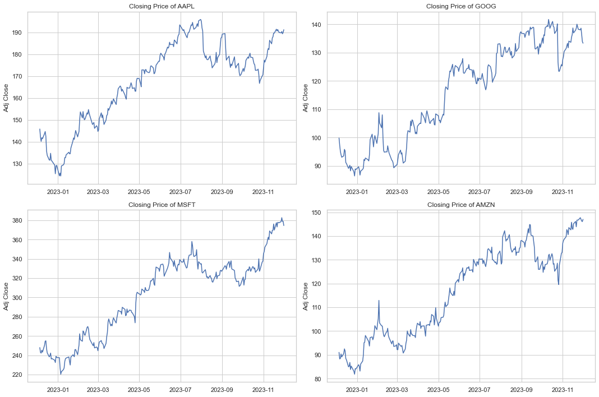
Closing Price
The closing price is the last price at which the stock is traded during the regular trading day. A stock’s closing price is the standard benchmark used by investors to track its performance over time.

Slide 7
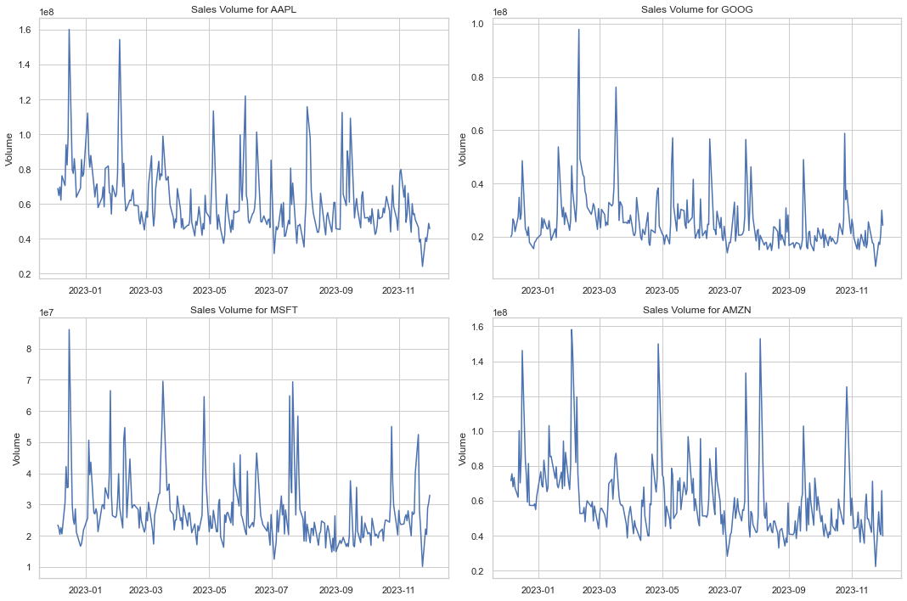
Volume of Sales
Volume represents the quantity of a financial asset traded during a specific timeframe, typically within a day. For stocks, it refers to the number of shares exchanged between the opening and closing prices. Changes in trading volume are crucial for technical traders, offering insights into market dynamics.

Slide 8
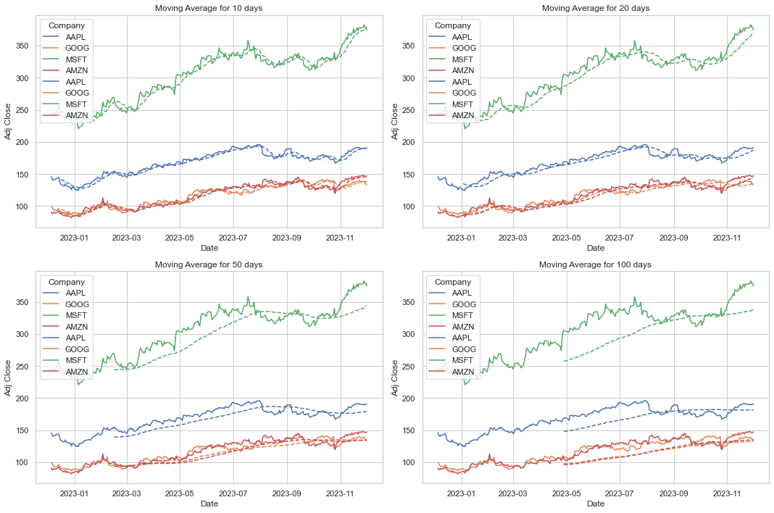
After exploring visualizations of daily closing prices and trading volume, let's now compute the moving average for the stocks. The moving average is a tool that smoothens price data, providing an ongoing average over a chosen timeframe, enhancing our understanding of the stock's trends.

Slide 9
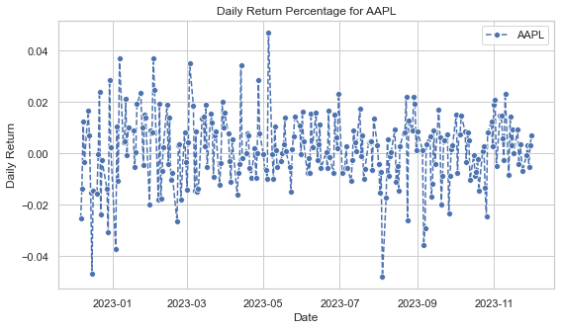
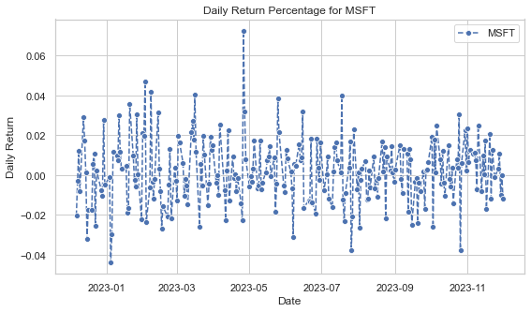
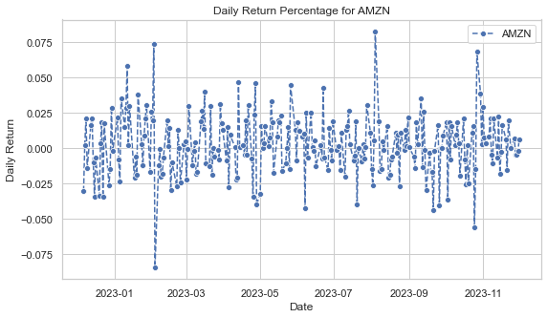
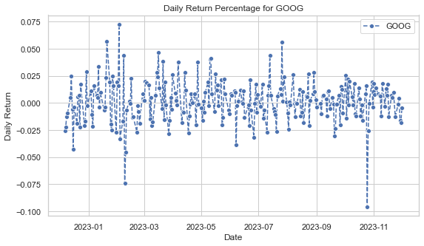
Looking deeper into our analysis by examining the average daily return of the stock. To assess the stock's risk, we'll focus on the daily changes rather than its absolute value.

Slide 10
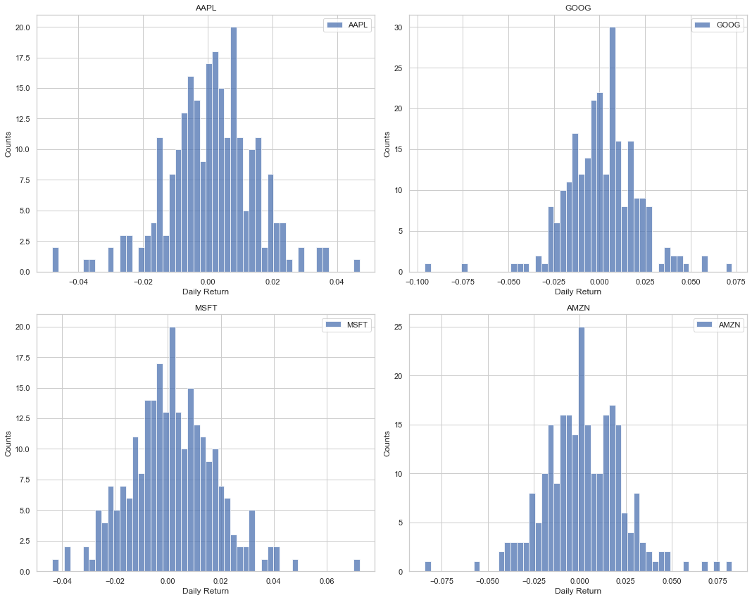
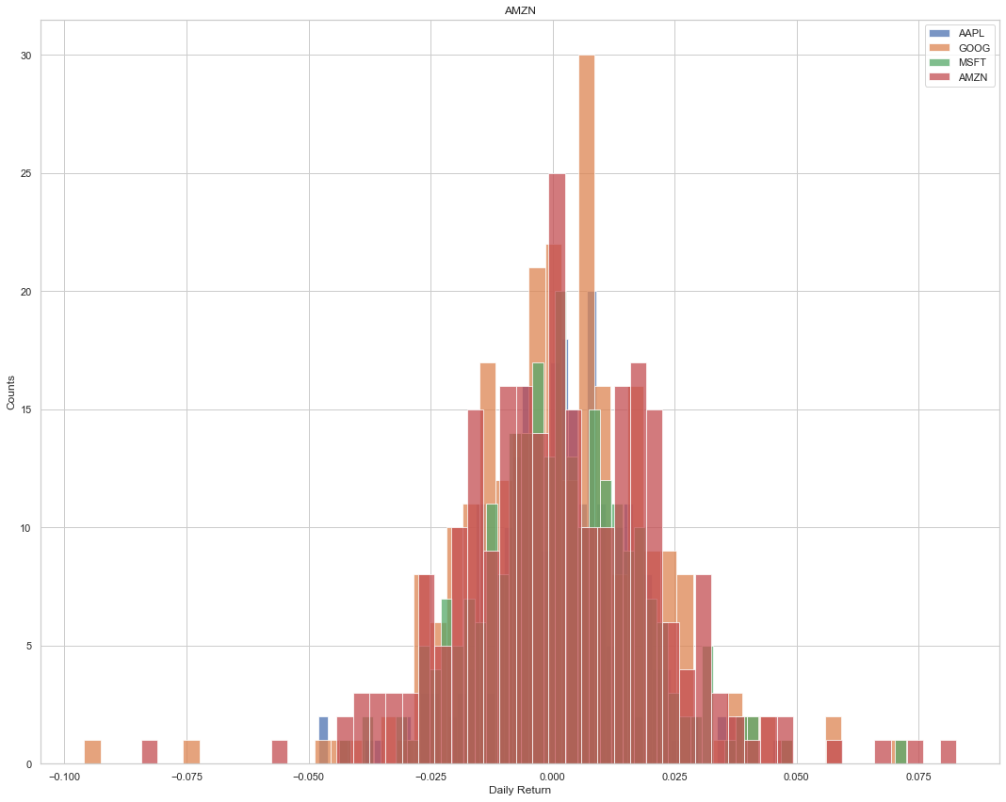
Now, to grasp the average daily return, we'll visualize it with a combined histogram and kernel density plot using seaborn. This provides a comprehensive overview of the distribution of daily returns for the selected stocks.

Slide 11
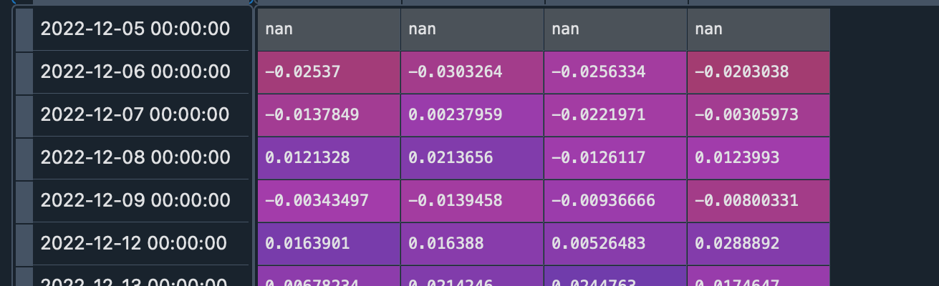
We assessed the correlation between closing prices of different stocks. Correlation, ranging from -1 to +1, gauges how two variables move together. It doesn't indicate casuation. To analyze returns for all stocks, we created a Data Frame with their 'Close' columns.

Slide 12
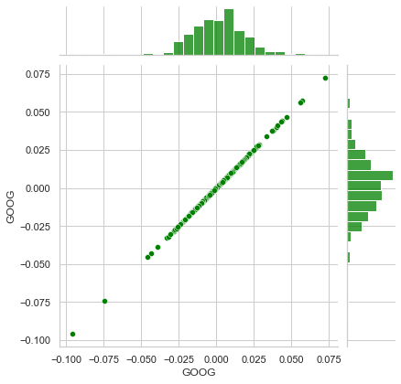
When two stocks are perfectly and positively correlated, their daily returns show a clear linear relationship. Seaborn and pandas make it easy to visualize this for all stock pairs in our tech list

Slide 13
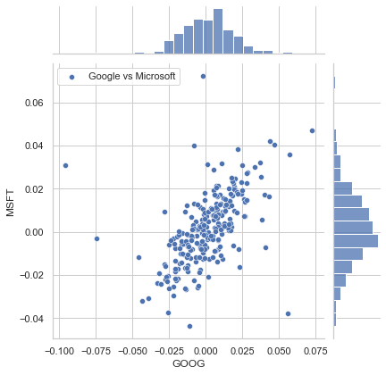
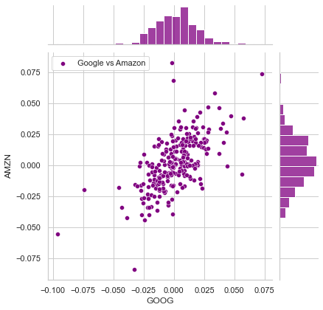
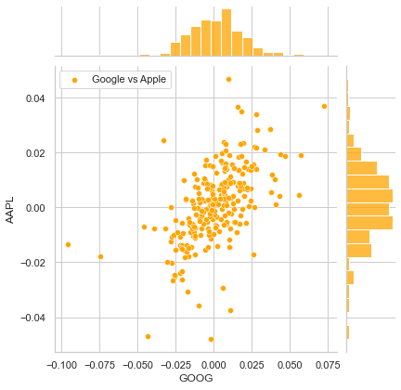
Now, we can examine how the daily percentage returns of two stocks are correlated.

Slide 14
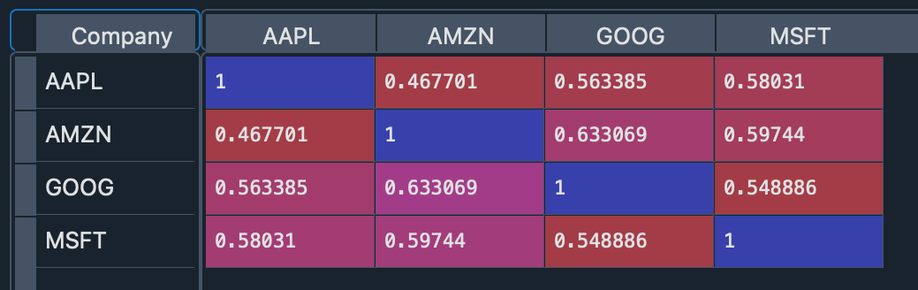
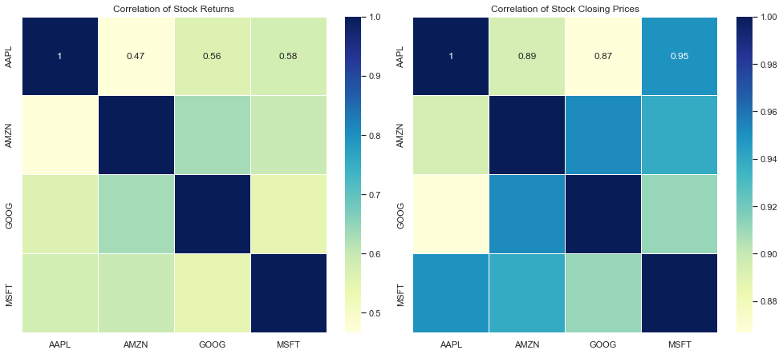
In analyzing daily stock returns of top tech firms (Google, Microsoft, Apple, Amazon), we discover intriguing connections. Notably, Microsoft and Apple share a prominent link seen in both numbers and visuals. Closer scrutiny reveals Microsoft and Amazon boast the strongest correlation, indicating synchronized movements, possibly influenced by shared industry factors.

Slide 15

Summary & Conclusion:
Correlation Insights: Positive correlations among tech stocks suggest a collective market movement. Diversification remains crucial for risk management.
Volatility Dynamics: Analysis of daily returns and histograms provides a snapshot of stock volatility, aiding in setting risk tolerance levels.
Predictive Modeling: Linear regression models offer predictive capabilities, allowing for trend forecasting based on historical stock movements.
Statistical Significance: Interpretation of regression results involves assessing statistical significance through p-values and confidence intervals.
Continuous Learning: The dynamic nature of financial markets emphasizes the need for continuous learning and adaptation.
Holistic Decision-Making: A comprehensive approach combining technical, fundamental, and macroeconomic factors leads to well-informed decisions.
Technology Sector Evolution: Monitoring emerging trends, technological advancements, and regulatory changes is crucial in the rapidly evolving tech sector.
Long-Term Perspective: While short-term analyses guide tactical decisions, a long-term perspective is vital for building a resilient investment portfolio.
This analysis equips investors with valuable insights for navigating the ever-changing landscape of the stock market.

Slide 16

THANK YOU

